Slide 1
Economic Complexity
LEA – Affaires Internationales
Pierre-Alexandre Balland
Harvard University
CEPS
Toulouse Artificial Intelligence Institute (ANITI)

Slide 2
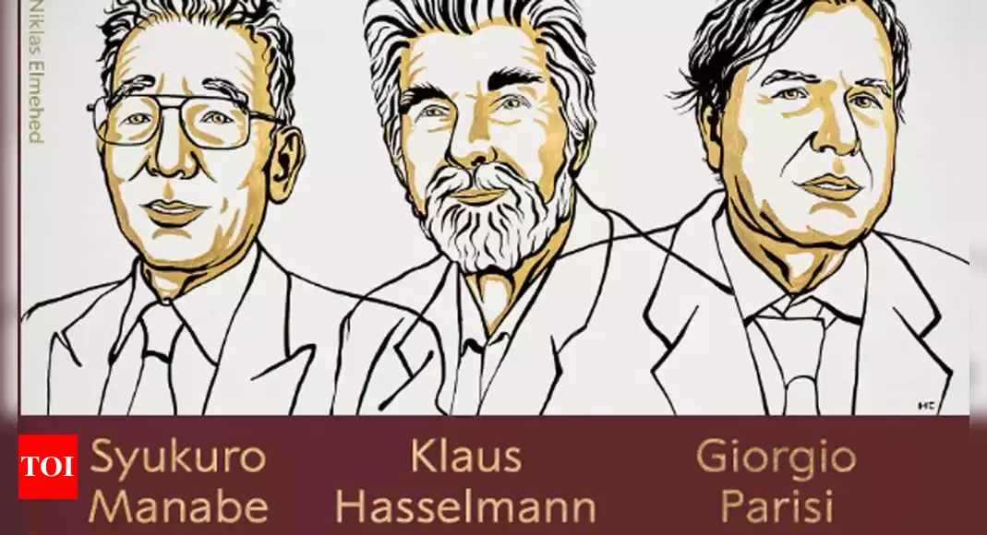
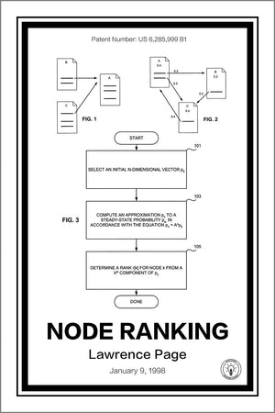



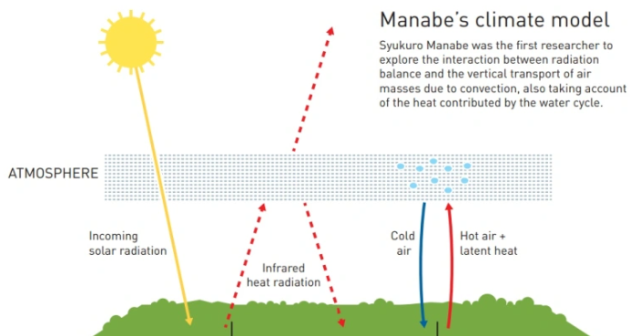
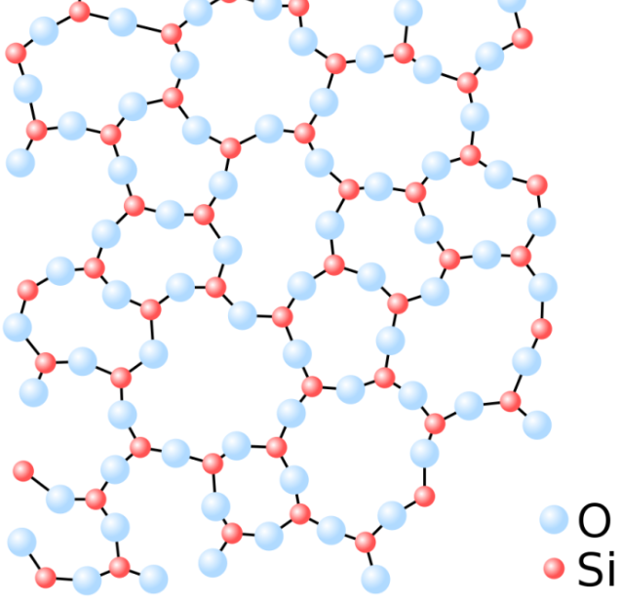


The Century of Complexity
2021’s Physics Nobel Prize is about Complexity Science
AI applications extract information from complex network structures
Notes:
Stephen Hawking (2000): in response to a question about the way that science is developing, replied: “I think the next century will be the century of complexity”

Slide 3
What is Economic Complexity?
Economic complexity is the application of complex systems and network thinking to economics
Paradigm shift from isolated characteristics to systemic interactions
-> To understand emerging patterns of growth, regional evolution, technological change, inequality, sustainability…
Economic complexity produces useful heuristics and metrics to make better business and policy decisions
Notes:
X has produced new metrics that can be used to develop automated recommendation systems
Complexity can be measured in 2 main ways: input-based(NK) or output-based (ECI/TCI)
It is also a large, young, growing community

Slide 4

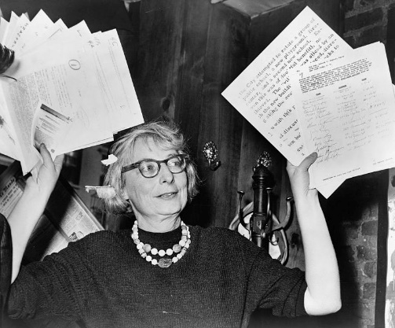
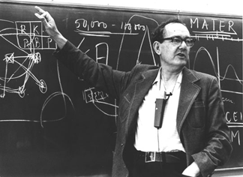


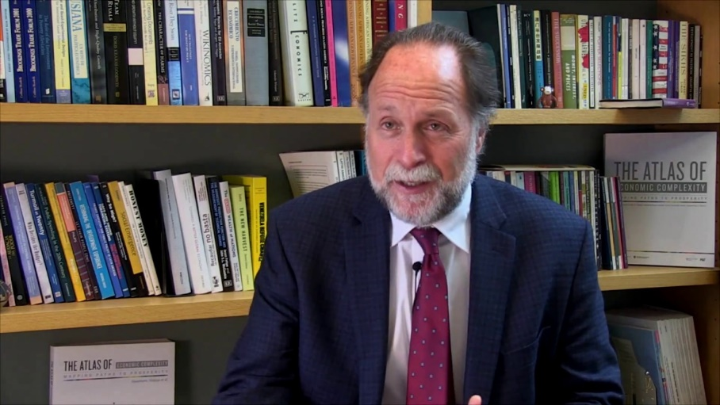

Founding parents

Slide 5
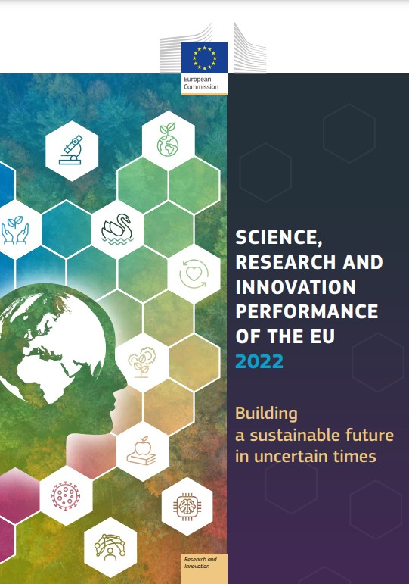


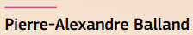


Recent reads

Slide 6
Transition to system thinking
Key concepts of interdependencies, non-linearity, feedback loops, self-organization, second-order effects, randomness, scaling, fat-tails, network effects, path-dependence…
- Industry 5.0, a transformative vision for Europe : governing systemic transformations towards a sustainable industry
- Global value chains : harnessing innovation to protect and transform the backbone of global trade
- Protect, prepare and transform Europe - Recovery and resilience post COVID-19

Slide 7
EconX & growth
Economic development from a complex systems perspective
As the economy becomes more complex, it grows
New technologies and globalization allow for a deeper division of knowledge
Trade and division of labor and this is a very efficient way to organize the economy

Slide 8
Yes, But!
Increasing complexity creates an overload of information and noise
This division of knowledge also creates room for hierarchy and inequality
Complexity makes key resources very, very concentrated (hello network effects)
Increased interdependencies make us more vulnerable to pandemics such as Covid-19, financial, and ecological crises

Slide 9
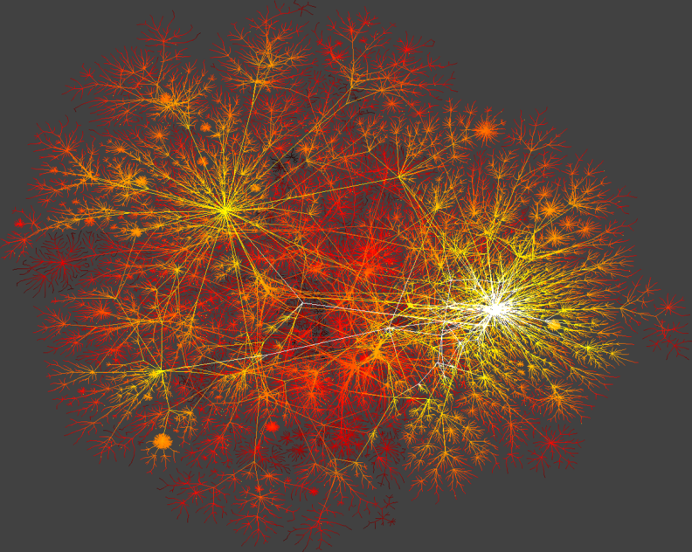
Complex systems are highly unequal
More complex societies are more unequal because large networks create extreme leverage

Slide 10
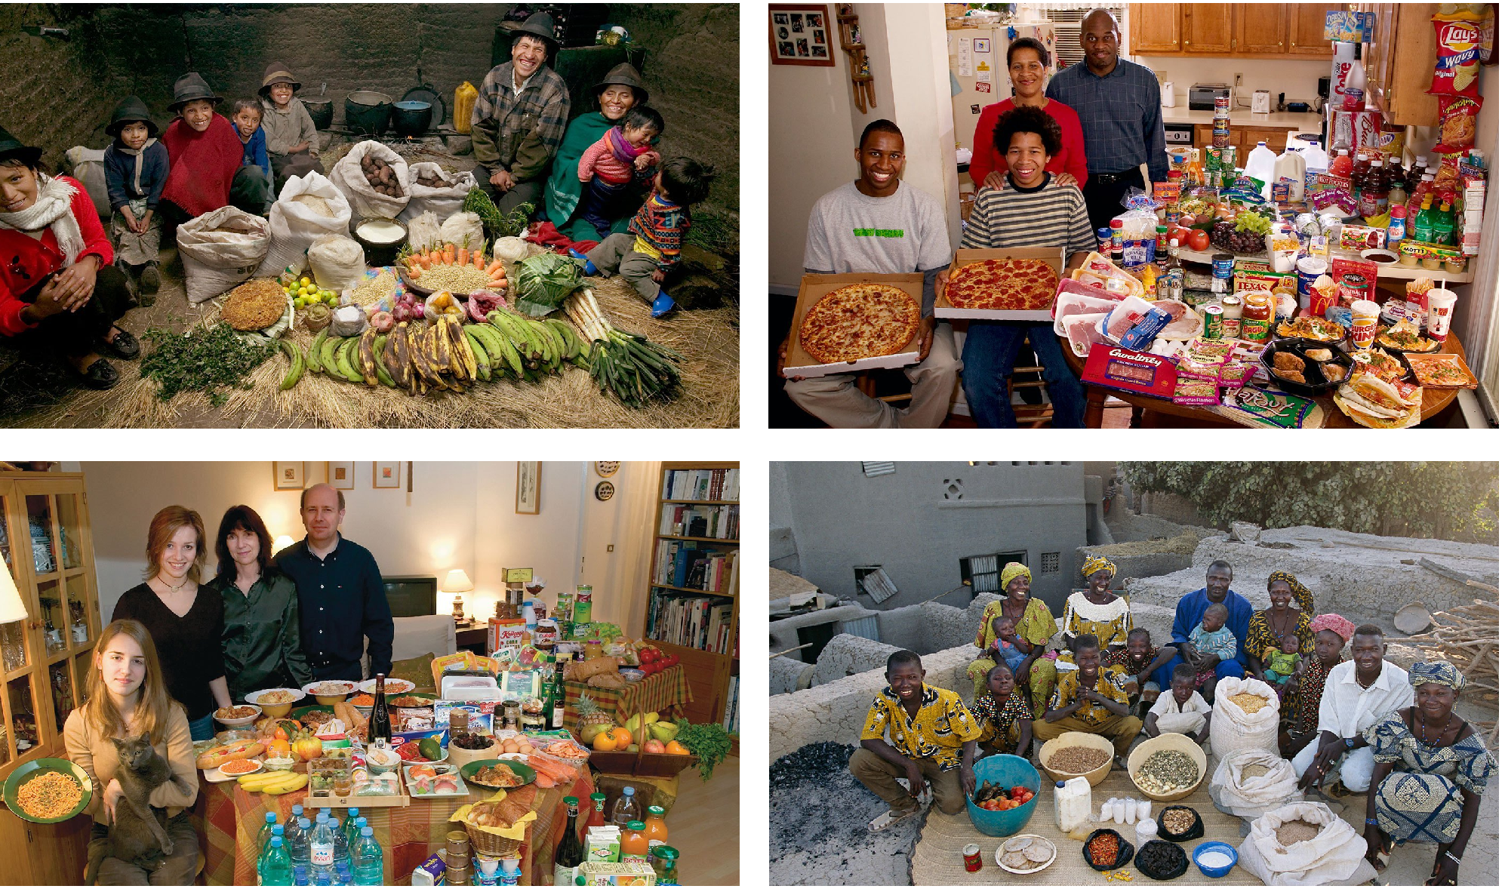
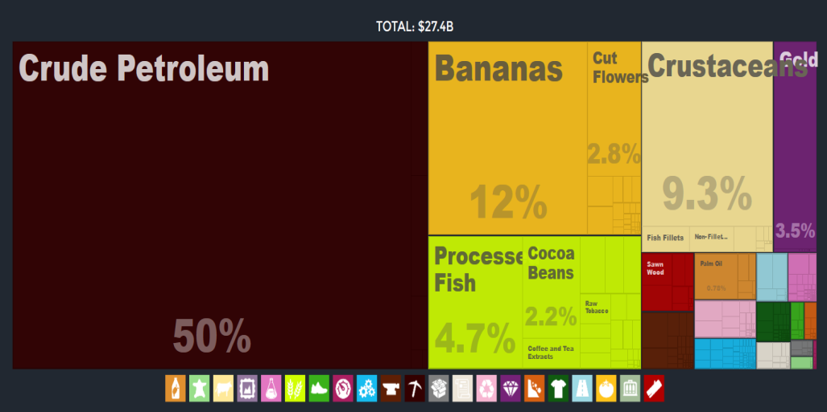
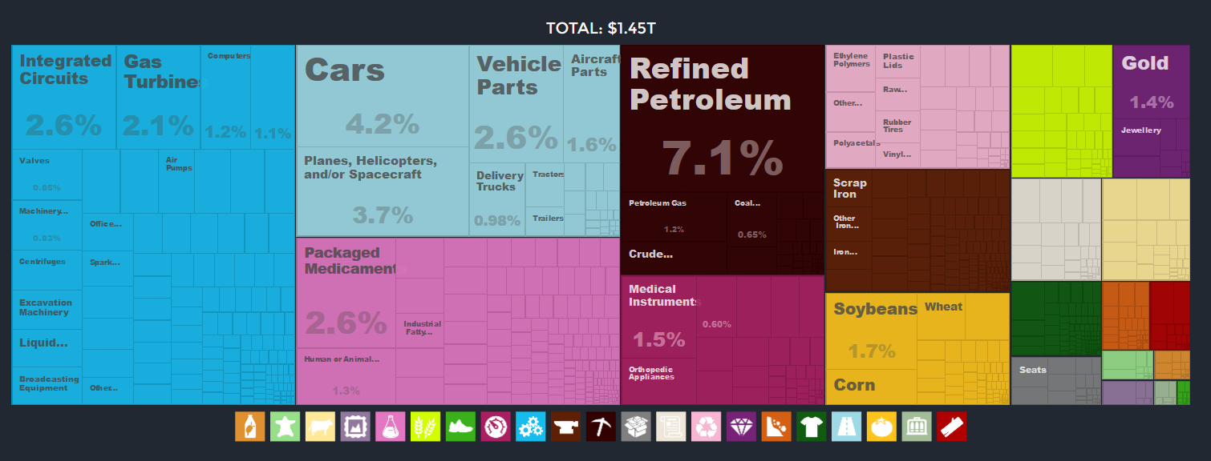
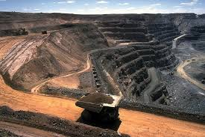
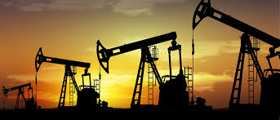
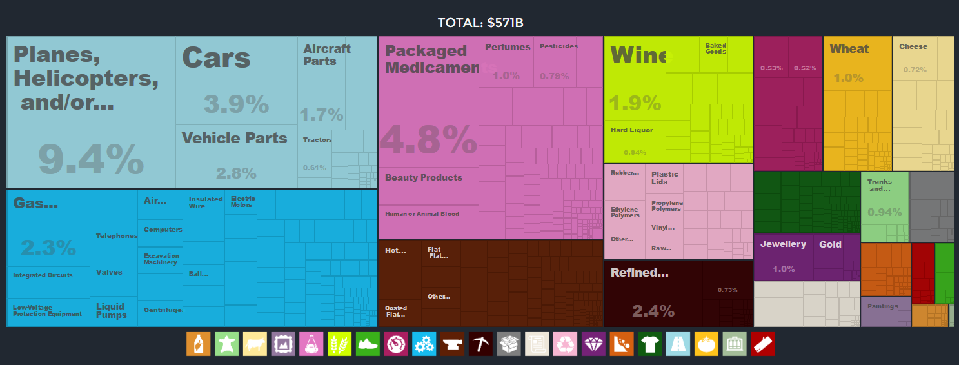
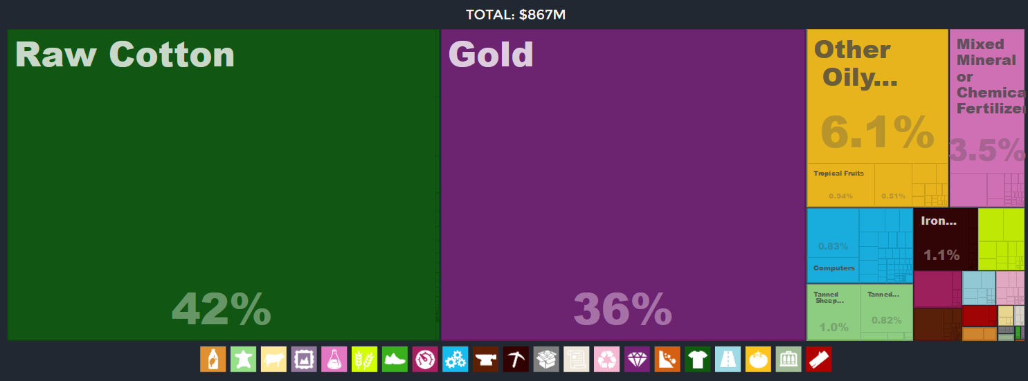
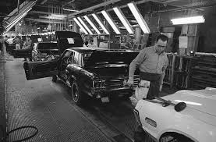
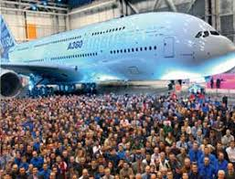
Reframing economic development
USA – $48.19/day | 1.00% < Pov.
France– $43.17/day | : 0.08% < Pov.
Mali – $1.92/day | 49.25% < Pov.
Data Source: atlas.media.mit.edu
Menzel, P. and D’Aluisio F. (2005) Hungry Planet: What the World Eats
Notes:
Path to properity, really about understanding how to move from there to there
Data is from the PovcalNet database from the World Bank
International poverty line by the world bank: 1.9 $ PPP (Purchasing Power Parity)
<pov: % of population living in households with consumption or income per person below the poverty line ($1.9/day)
"Median$" is the median of daily per capita income/consumption expenditure from the survey in 2011 PPP.
Given monthly in Povcalnet but I multiplied by 12 and divided by 365 to get it daily
> 248.505*12/365
[1] 8.170027
> 1313.09*12/365
[1] 43.17008
> 58.5022*12/365
[1] 1.92336
> 1465.7*12/365
[1] 48.1874

Slide 11
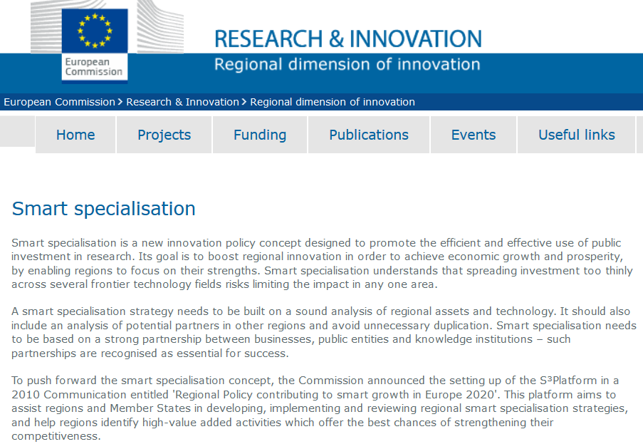
On smart specialization

Slide 12


Applied AI for innovation policy
Recommender systems are the most successful application of AI in the business world. They are all about filtering massive amount of data (content-based filtering & collaborative filtering)
Economic complexity tools are based on similar machine learning algorithms
→ Can support innovation policy & smart R&I investments
Notes:
Spotify (launched in 2008): 82 million tracks (3.6 million podcast titles) - most popular audio streaming subscription service with 406m across 183 markets
Facebook leverages Apache Giraph, which is a iterative graph processing framework built on top of Hadoop
Content-based filtering
Analyzes the content (characteristics) of each item
Finds similar items
Recommends the most similar item to the one you like
Collaborative filtering [Graph-based ML]
Analyzes connections between users and items (likes, buy…)
User-User Collaborative Filtering: finds similar users
→ recommends products bought by the most similar users to each other
→ Item-Item Collaborative Filtering: recommends products frequently bought together

Slide 13

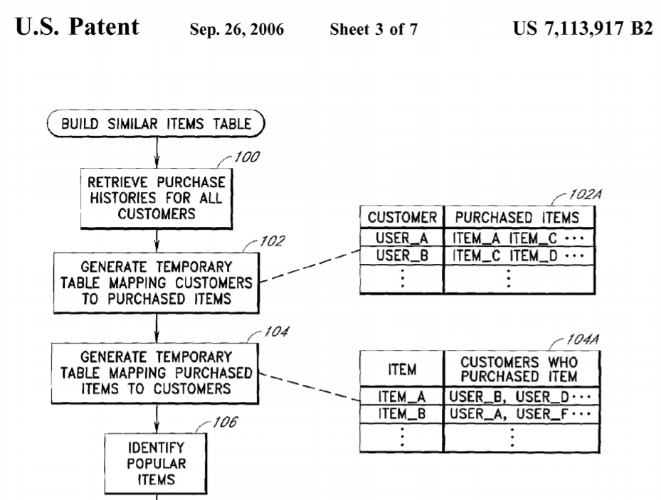
Matching products and customers
A
B
C
D
1
2
3
4
5
Modern AI techniques extract information from network structures

Slide 14
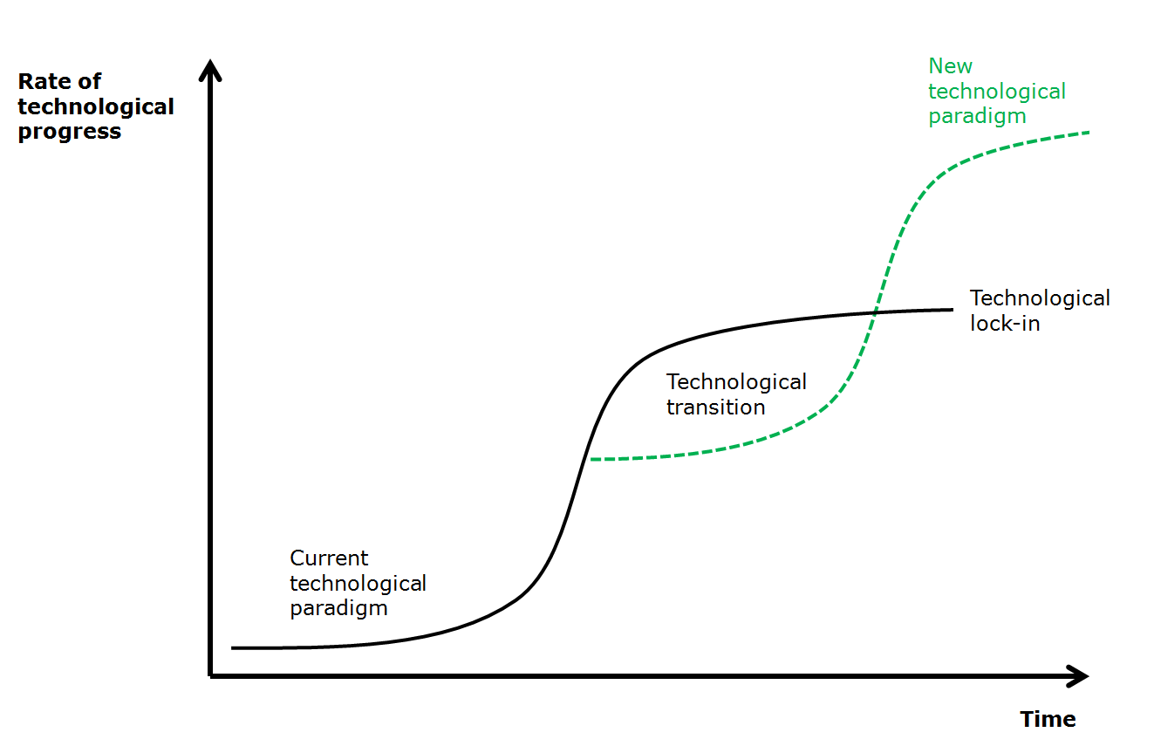

Slide 15
Policy support

Slide 16
Smart Occ Investment Framework
Complexity
High Risks
High Benefits
Low Risks
High Benefits
High Risks
Low Benefits
Low Risks
Low Benefits
Relatedness

Slide 17
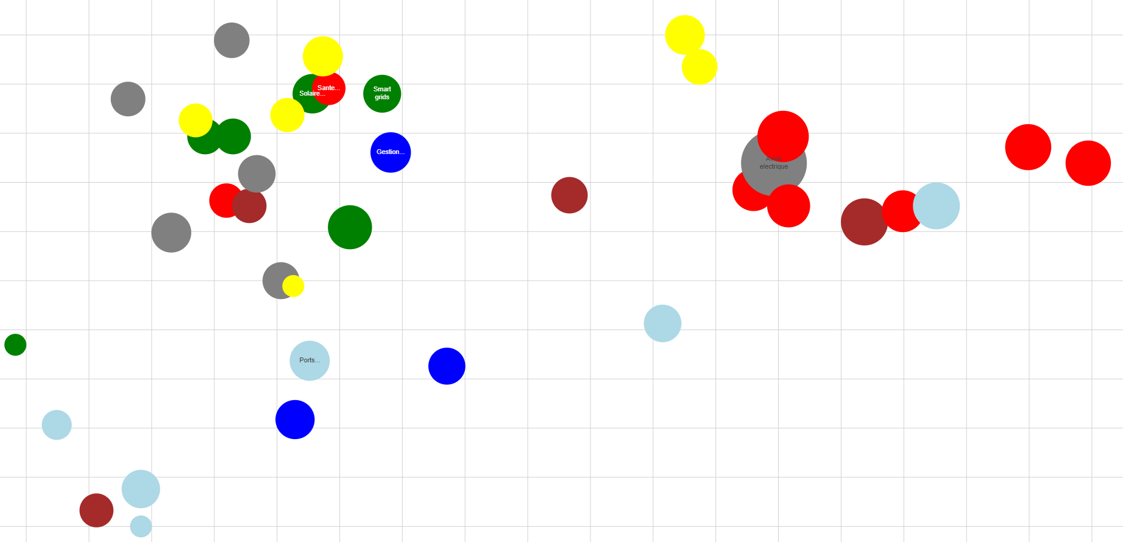
Smart Occ Investment Framework
Embedded Systems
Complexity
Batteries
Oncology
Smart grids
Composites materials
Electrical plane
Biotherapies
Protein of the future
Off-shore wind turbines
Geosciences
Relatedness

Slide 18
Q&A

